Slide 1

Marketing Retail Analytics - Capstone
By Vishnu Vardhan Reddy DuMBALA

Slide 2
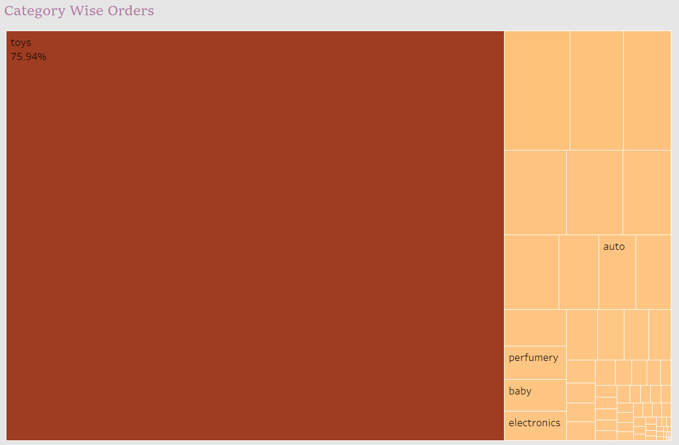
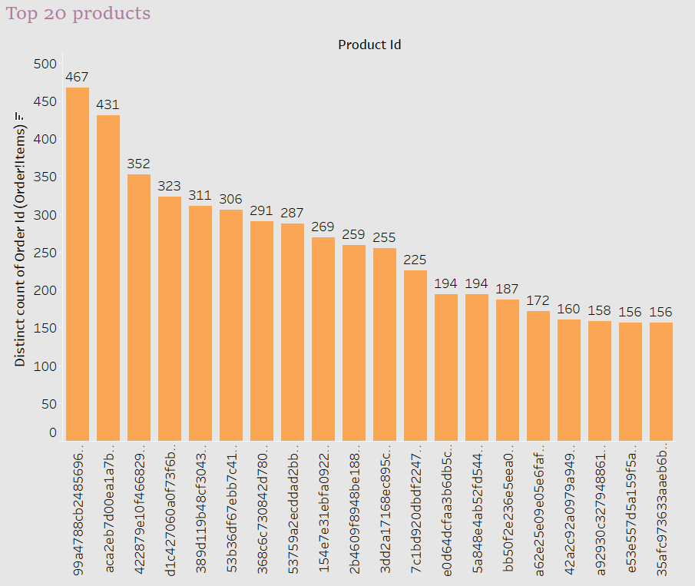
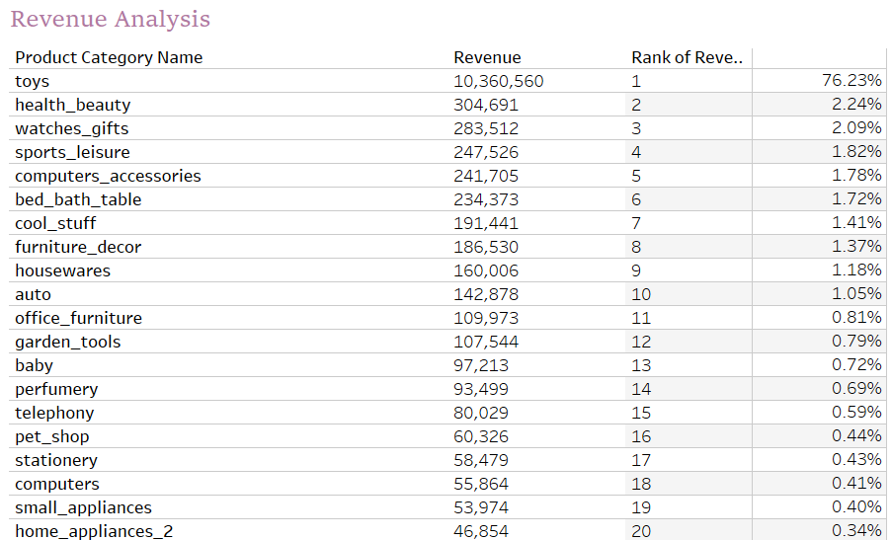
Executive Summary
Top Ordered Products:
Toys are part of the TOP 20 Products as per the Analysis (Toys order percentage
75.94%
Revenue Contribution:
It is clearly evident that Toys are contributing to Most of the Revenue.
I.e. 76.23%

Slide 3
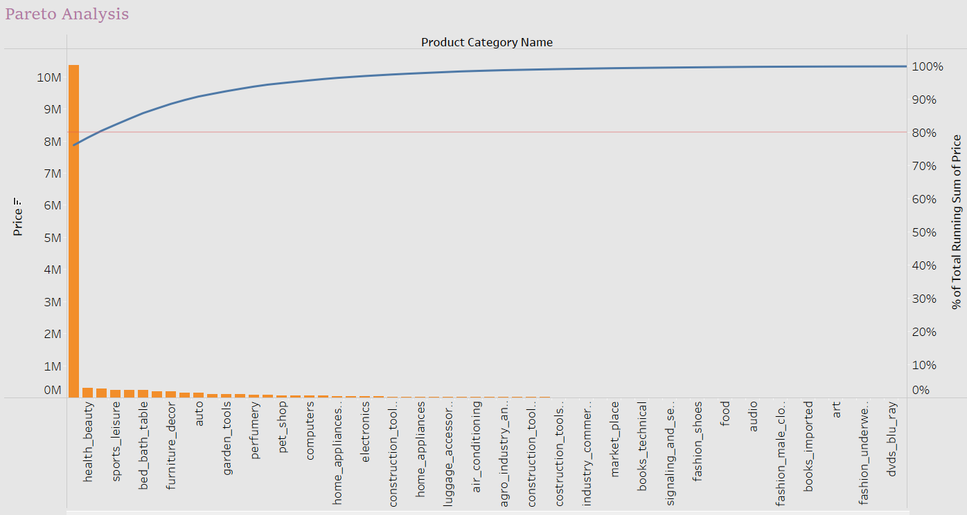
Executive Summary
Pareto Analysis
As per the Pareto Analysis (80-20 rule) , Toys, health_beauty, watches_gifts are the products that are contributing to 80% of revenue. Which means 80 % of company revenue is getting generated from these products.

Slide 4
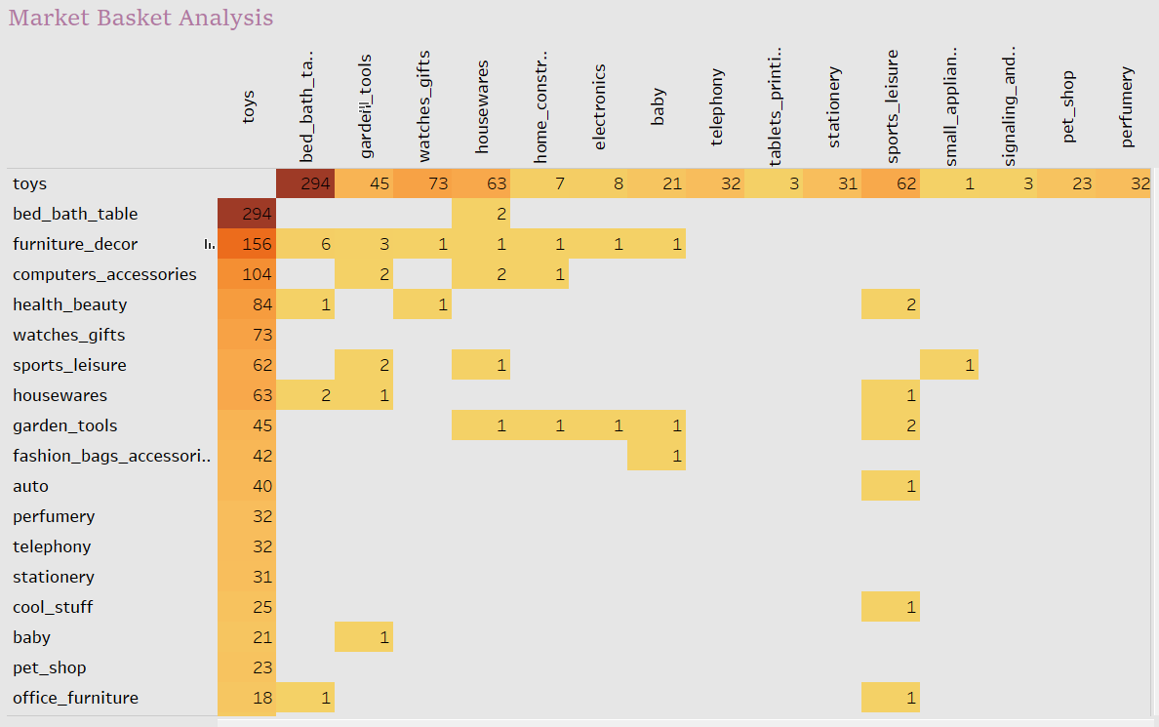
Executive Summary
Market Basket Analysis
As per the analysis, bed_bath_table, furniture_decor,computer_accessories, health_beauty, watches_gifts, housewares are frequently ordered products along with toys

Slide 5
Executive Summary
Recommendations:
Toys are generating most of the revenue, selling most, which means these are fast moving products when compared to other products. So, company has to store more toys to meet the demand of customers.
bed_bath_table, furniture_decor,computer_accessories, health_beauty, watches_gifts, housewares are frequently ordered products along with toys So we can recommend them to customers when they are planning to buy toys. Also we have to maintain these products in our inventory.
Also company can avoid storing least selling products such as home_comfort_2 etc... Thus the company can reduce their storage costs.

